Slide 1
CAN Errors
AGENDA
What is CAN Error
Reaction to CAN error
Types of CAN error
Understanding each type
What are Tx and Rx errors
Various scenarios and exceptions
Shyam Bhat
VicharaVandana

Slide 2
What is CAN Error
Purpose of CAN: Communicate data from one node to other nodes in a network.
The data to be communicated is clubbed with frame related fields and communicated serially bit by bit
All the Rx nodes must receive the same information which the Tx application is intended. If some problem happens in this then we call as CAN error.
The problem may happen in Tx node, or CAN bus or Rx node. CAN protocol has capability to detect any such problem and raise an error flag.
So Depending on which node detects an error we have Tx errors and Rx errors

Slide 3
Reaction to CAN Error
When a node (Tx or Rx) detects a CAN error it starts sending the error flag on the bus immediately.
This Error flag is designed in a way that it destroys the data frame currently present on the bus.
Depending on this error flag other nodes also may put its own error flags on CAN bus.
All Error flags and delimiters together forms the error frame on the bus.
Depending on the node which raised the error flag, will increment its error counter value to keep track and manage CAN error states.

Slide 4
CAN Errors
There are 5 types of CAN errors
Bit Error
Acknowledgement Error
CRC Error
Stuff Error
Form Error
Bit Error and Ack Error are called Transmitter errors
These decide the TEC counter increments
CRC, Stuff and form errors are called Receiver errors
These decide the REC counter increments

Slide 5
Bit Error
When the transmitter node monitors a different bit value than the value it transmitted in that bit, then its called as a bit error
Tx bit Sequence
Bit Error
Bit Monitoring
CAN Bus

Slide 6
Bit Error Exceptions
Use cases:
Tx puts Dominant (0) bit but finds a Recessive(1) bit on the bus
Tx puts Recessive (1) bit but finds a Dominant (0) bit on the bus
Exceptions:
1) During Arbitration, Tx puts a Recessive bit but finds a Dominant Bit then this means Lost in Arbitration and not Bit Error.
Note: During Arbitration if Tx node puts a Dominant bit but finds a Recessive bit on the bus, then this is a Bit Error only.
2) During Acknowledgement Slot, Tx node puts a Recessive bit but finds a Dominant Bit then this means Acknowledgement Received and not Bit Error.
3) After Ack slot, 11 consecutive Recessive bit is transmitted. In that fixed frame if a dominant bit is monitored then it will be a form error and ot Bit error.

Slide 7
Acknowledgement Error
When the transmitter node monitors a Recessive bit value in Ack Slot, then it means it did not get a Acknowledgement. This is Acknowledgement Error
CRC Error
When the Reciever Node has not given acknowledgement but still monitors a dominant bt in ACK slot, then it’s a CRC Error.
Tx Node
Rx Node 1
Rx Node 2
CAN BUS

Slide 8
Case 1: No Error

Slide 9
Case 2: Acknowledgement Error

Slide 10
Case 3: CRC Error

Slide 11
Stuff Error
When a receiver receives at-least 6 consecutive bits of same polarity, then it means the bit stuffing rule is violated. This is Stuff Error.
In CAN protocol, if frame has consecutive 5 bits of same polarity then a complimentary bit is inserted after that called Stuff bit. This helps in better synchronization between Rx and Tx nodes.
Bit Stuffing is applied from SOF to Checksum field. So the scope of stuff error also is the same.
The moment the Stuff error is detected, the Rx node raises an error flag the very next bit, hence destroying the current data frame on the CAN Bus.

Slide 12
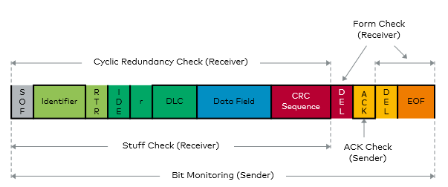
Form Error
When the Fixed form of the CAN data frame (CD + AD + EOF) is altered then Form error occurs.

Slide 13
Points to Remember
When a node Detects a error, it raises the error flag on the bus and destroys that data frame which is erroneous.
If the error is detected by a Tx node then they are called Tx Errors. Bit and Ack errors
If the error is detected by a Rx node they are Rx Errors. CRC, Form and Stuff errors
For Ack, Bit, Form and Stuff error, The error flag is raised as on the very next bit when the error was detected, For CRC error, error flag is raised after 1 bit gap(AD) when error is detected.
Tx error results in increments of TEC and Rx errors result in REC within a node.
Error frame format for all CAN error are same. Depending on at which part of data frame the error is raised, we can know which error is it.

Slide 14


